Slide 1
The (Emerging) Role of Subcategories
Ion Gâlea

Slide 2
Starting point: Legal basis of partial use
Regulation 2017/1001 - proof of genuine use in:
Article 47 (2) – opposition proceedings
Article 64 (2) – invalidity proceedings
”only part of the goods or services”
Article 58 (1) a) and (2) – revocation proceedings
” some of the goods or services”

Slide 3
Principles
Judgment of 14/07/2005, Reckitt Benckiser (España)/OHMI – Aladin(ALADIN), T-126/03, EU:T:2005:288, p. 46
”(...) a category (…) which is sufficiently broad for it to be possible to identify within it a number of subcategories capable of being viewed independently” /
“registered for goods or services defined so precisely and narrowly that it is not possible to make any significant subdivisions within the category concerned”
Judgment of 16/07/2020, ACTC/EUIPO, C-714/18P, EU:C:2020:573, p. 42
it is sufficient to require the proprietor of the earlier mark to adduce proof of genuine use of that trade mark in relation to part of the goods or services in that homogeneous category”
Registered | Used | Accepted
Polish for metals (Class 3) | Products for polishing metals consisting of cotton impregnated with a polishing agent | Polish for metals

Slide 4
Criteria:
”since consumers are searching primarily for a product or service which can meet their specific needs, the purpose and intended use...” [Judgment of 13/02/2007, Mundipharma/OHMI – Altana Pharma (RESPICUR), EU:T:2007:46]
Registered | Used | Accepted
Pharmaceutical preparations | Multi-dose dry powder inhalers containing corticoids | Therapeutic preparations for respiratory illness
”(…) must be applied coherently and specifically”
”if [...] the goods concerned have several purposes and intended uses, determining whether there exists a separate subcategory (…) by considering in isolation each of the purposes (…) will not be possible (...)” [Judgment of 16/07/2020, ACTC/EUIPO, C-714/18P, EU:C:2020:573, p. 50, 51]
Registered | Used | Accepted
Clothing; outer clothing; underwear; headgear for wear and headwear; working overalls; gloves; belts and socks | Weather protective outdoor clothing Purpose of «protection» - irrelevant | Clothing; outer clothing; underwear; headgear for wear and headwear; working overalls; gloves; belts and socks

Slide 5
Applying the criteria to facts
18/10/2016, August Stork/EUIPO – Chiquita Brands (Fruitfuls), T-367/14, EU:T:2016:615 | Registered | Used | Accepted
 | Confectionery | Hard fruit candies | Confectionery
 | ”The purpose of confectionery is to be consumed for enjoyment, not to meet nutritional needs” (para. 33)
07/06/2023, Medex/EUIPO – Stein (medex), EU:T:2023:318 | Registered | Used | Accepted
 | Pastry (Class 30) | cookies | Cookies
 | “ (…) on the ground that the intended use and purpose of ‘cookies’ could differ from those of other types of ‘pastry’ “ (para . 51)
24/01/2024, Agus/EUIPO – Alpen Food Group (ROYAL MILK), T-603/22, EU.T:2024:29 | Registered | Used | Accepted
 | Milk and milk products with the exception of ice creams and milk desserts | Milk powder for food purposes | Milk powder for food purposes
 | “ (…) some of the characteristics of the goods at issue are of significant importance in directing his or her choice and that they therefore have a bearing on the purpose and intended use of those goods in his or her eyes (…) milk powder has a much longer shelf life than liquid milk and does not need to be refrigerated” (p. 33, 34).

Slide 6
Applying the criteria to facts
12/07/2023, Trus/EUIPO – Unilab (ARTRESAN), T-585/22, EU:T.2023:392 | Registered | Used | Accepted
 | ‘food supplements for medical purposes’ (class 5) | products to improve the condition of the joints | ‘food supplements for medical purposes’
 | (...) are intended to supplement a normal diet and to improve human health. Similarly, products to improve the condition of the joints are intended to improve human health and, more specifically, the condition of the joints, [which is] part of the human health (p. 70)
17/12/2025, Freixenet/EUIPO – Alvear (CB), T-222/25, EU:T:2025:1117 | Registered | Used | Accepted
 | ” wine” | ‘Fino’ wines | ” wine”
 | ‘Fino’ wine and the broader category of wines serve the same purpose, as they are both alcoholic beverages produced by the fermentation of grapes, intended for consumption in similar contexts, and offer similar sensory experiences in terms of aroma, taste and texture (p. 33).
09/03/2022, PrenzMarien / EUIPO - Molson Coors Brewing Company (UK) (STONES), T-760/20, EU:T:2022:123 | Registered | Used | Accepted
 | ”beer” | ”bitter beer” | ”beer”
 | it is common ground that bitter beer constitutes a kind of beer. There is no difference in purpose or intended use between the goods ‘Beer’ and ‘Bitter beer’ or, moreover, a sufficiently clear delimitation to define those goods as forming a separate category (p. 68)

Slide 7
Applying the criteria to facts
22/10/2020, Ferrari, C-720/18 and C-721/18, EU:C:2020:854 | Registered | Used | Accepted
 | Motor cars | Sport cars | Motor cars
 | the mere fact that the cars in respect of which a mark has been used are referred to as “sports cars” or “luxury cars” is not sufficient to consider that they belong to an independent subcategory of cars – para. 48, 49
23/09/2020, Polfarmex/EUIPO – Kaminski (SYRENA), T-677/19, EU:T:2020:424 | Registered | Used | Accepted
 | Motor vehicles | Racing cars | Racing cars
 | “are not intended to be driven on public roads and such use is even prohibited (…). Their purpose is therefore different from that of other cars” para 126.
05/10/2017, Versace 19.69 Abbigliamento Sportivo/EUIPO – Gianni Versace (VERSACE 19.69 ABBIGLIAMENTO SPORTIVO), T-366/16, EU:T:2017:691 | Registered | Used | Accepted
 | clothing | Luxury clothing | clothing
 | the EU judge has already refused to consider that luxury goods have a specific purpose or intended use, such as the satisfaction of the consumer’s hedonistic needs or the gratification of the immediate pleasure derived from an impulse purchase (p. 58)

Slide 8
Applying the criteria to facts
14/12/2006, Gagliardi/OHMI – Norma Lebensmittelelfilialbetrieb (MANU MANU MANU), T-392/04, EU:T:2006:400 | Registered | Used | Accepted
 | Clothing (class 25) | Tights for women | Tights for women
 | the product groups covered by the ‘clothing’ category are not sufficiently homogeneous; use of underwear, including, tights, cannot be regarded as proof for all other groups, in particular outerwear, such as trousers, shirts, jumpers (para 92).
28/05/2020, Diesel/EUIPO – Sprinter megacentros del deporte (Representation of a curved line) | Registered | Used | Accepted
 | Clothing (class 25) | Men and women’s denim jeans | Men and women’s denim jeans
 | “in so far as those goods constitute a consistent and homogenous subcategory” (para. 90)
07/06/2023, Brooks England/EUIPO – Brooks Sport (BROOKS ENGLAND, T-63/22, EU:T:2023:312 | Registered | Used | Accepted
 | Athletically-related footwear | Running shoes, racing shoes | Athletically-related footwear
 | elaborate reasoning - running shoes and racing shoes have the same intended use and purpose as ‘athletically-related footwear’ (p. 47-58)

Slide 9
Applying the criteria to facts
09/02/2022, Calzaturificio Emmegiemme Shoes/EUIPO – Inticom (MAIMAI MADE IN ITALY), EU:T:2022:59 | Registered | Used | Accepted
 | Clothing (class 25) | tracksuits, T-shirts, slippers, house shoes, beach and indoor shoes, trousers, polo shirts, T-shirts, jumpsuits, dungarees, skirts, flip-flops, cardigans, scarves, ballet flat (p. 96) | Clothing
 | ‘underwear, pyjamas and swimwear’ fall within the broader category of clothing, and that evidence of use in relation to these products also constitutes evidence of use in relation to the broader category of ‘clothing’. (p. 102) (an array of different articles of clothing and footwear)

Slide 10
Applying the criteria to facts
19/03/2025, e-dialog/EUIPO – Dialoga Servicios Interactivos (Dialoga), EU:T:2025:311 | Registered | Used | Accepted
 | Telecommunications services | Audio and video communications services, including SMS, fax2mail, sending and reception of calls, voice messages, video conferencing, WebRTC (WEB Real-time communication) | Telecommunications services
 | the Board of Appeal noted (…) that the category concerned was broad and included a variety of services that can, in principle, be divided into subcategories (p. 65); the Board of Appeal should have examined, in a concrete manner, whether the services at issue, having regard to their purpose or their intended use, were part of one or more coherent subcategories capable of being viewed independently, in particular by linking the services for which genuine use of the trade mark had been proven with the category of services covered by the registration of that mark (p. 65);

Slide 11
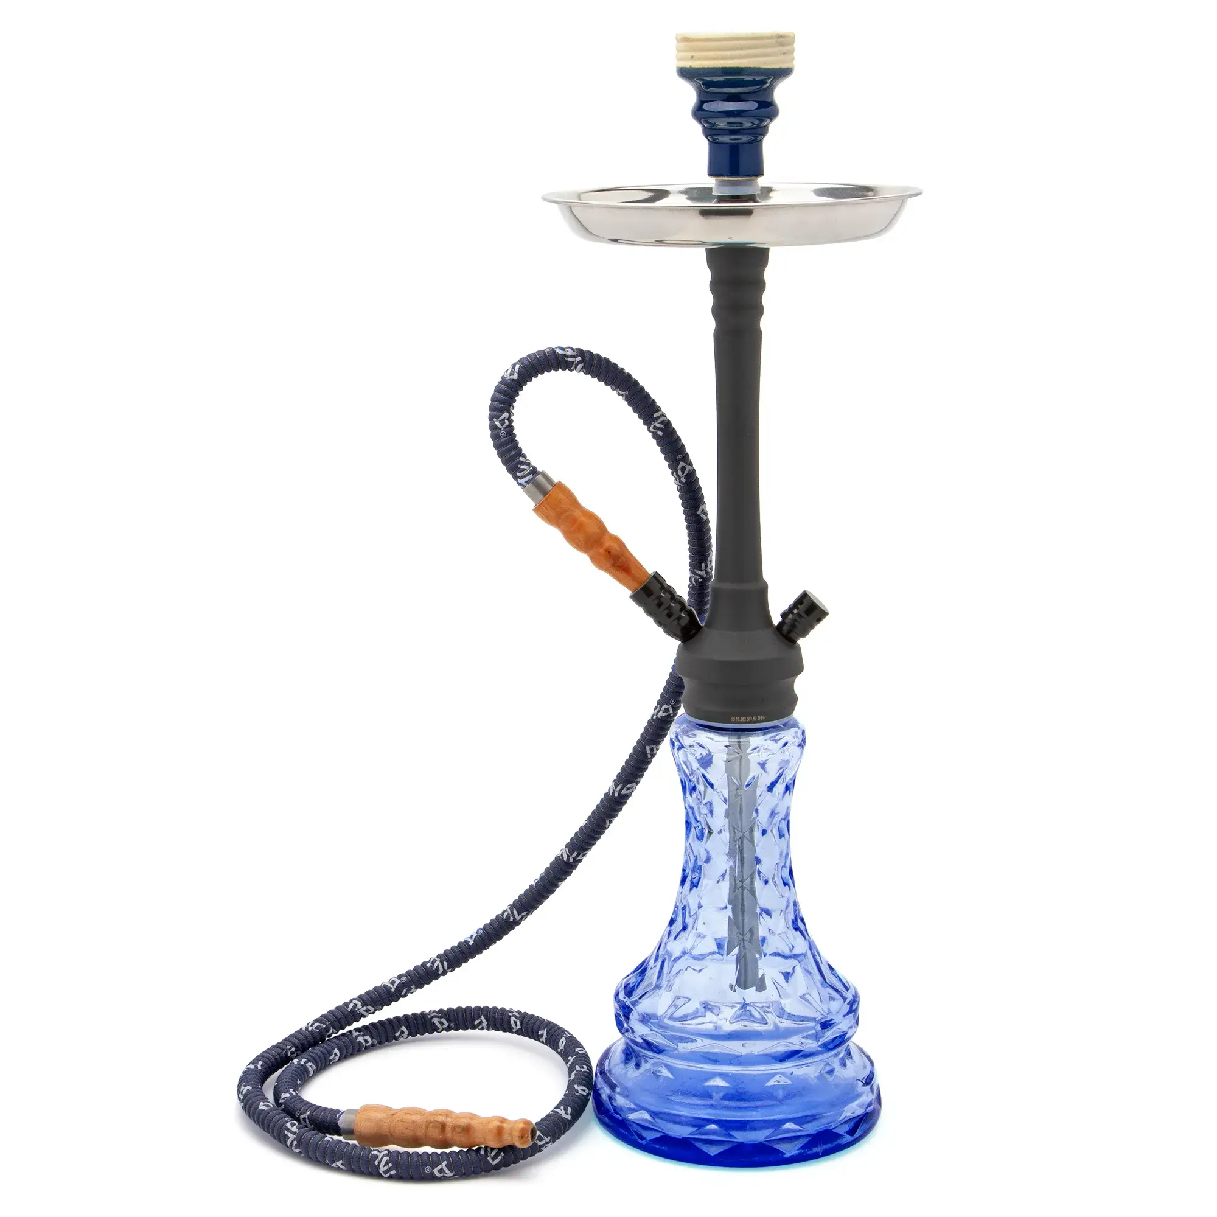
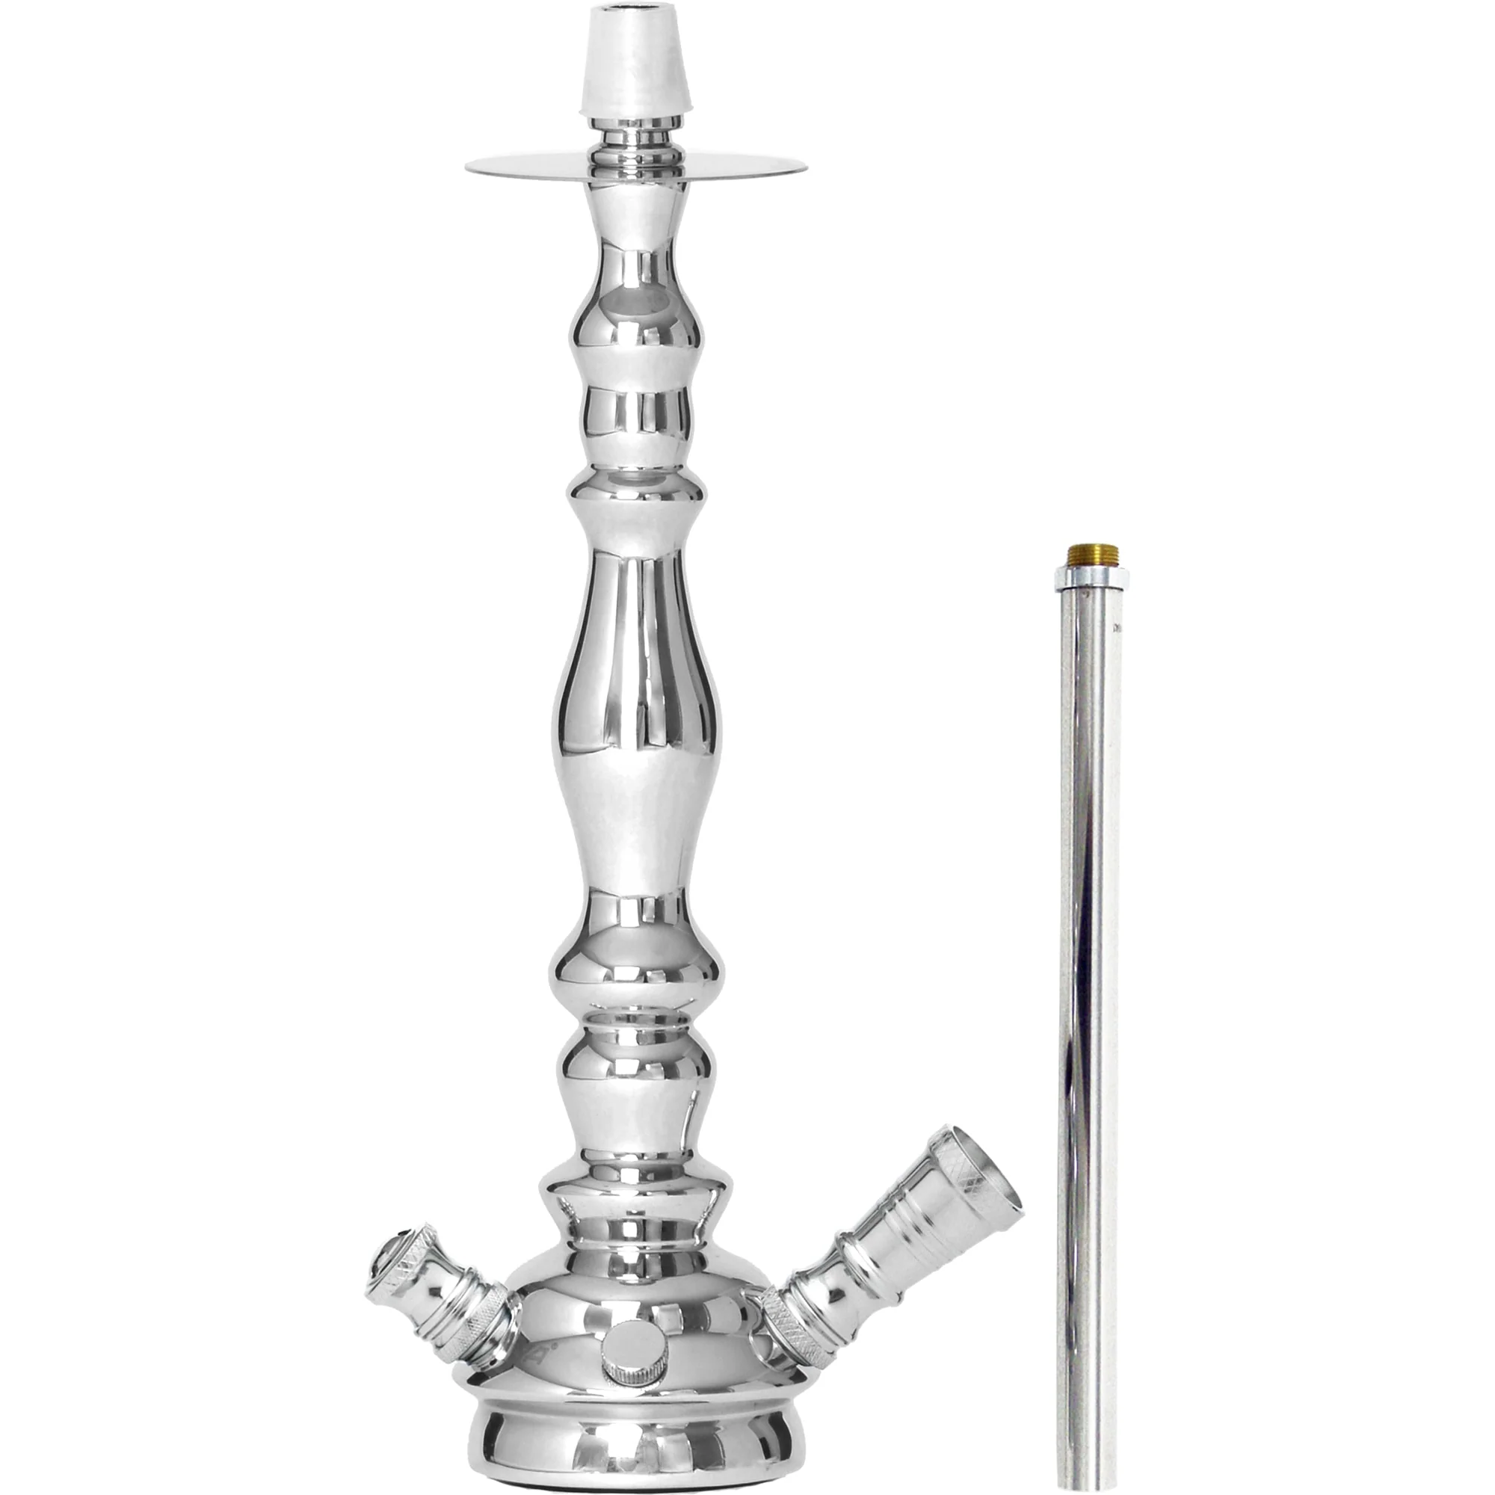
Applying the criteria to facts (2025)
03/09/2025, Starbuzz Tobacco/EUIPO – Mayflix (Discovery), T-404/24, EU:T:2025:826 | Registered | Used | Accepted
 | smokers’ articles, in particular hookahs | stems for hookahs | Hookahs
 | the criterion of purpose, which is of fundamental importance in the definition of a subcategory of goods, must be determined not by reference to whether or not goods must be combined with other parts before they can be used, but according to the specific needs of the relevant public which those goods meet (p. 32); BoA erred in concluding that the purpose of ‘stems for hookahs’ was different from that of ‘hookahs’ on the ground that the former must first be combined with other parts before they can be used (p. 34)

Slide 12
Applying the criteria to facts (2025)
09/07/2025, Bouwbenodigdheden Hoogeveen/EUIPO – Pürschel (BIENENBEISSER), T-144/24, EU:T:2025:804 (extended composition) | Registered | Used | Accepted
 | ‘Metal building materials, including air vents” (class 6); Building materials (non-metallic), including air vents’ (class 19) | Metallic air vents in class 6;
 | - the applicant argued that metallic and non-metallic air vents had the same intended use and purpose, namely to prevent bees and other insects or vermin from entering the spaces of brick structures, irrespective of the material in which those vents were manufactured. The applicant claimed that metallic and non-metallic air vents belonged to the same homogeneous category of goods, namely that of ‘air vents’ (40) - BoA: that the fact that metallic air vents can have some similarities with air vents made of other materials was not relevant in the present case; Failure to state reasons; - the Nice Classification is not crucial; it “does not allow a trade mark to be registered for the category of goods ‘air vents’ in a single class, but requires such registration to be made in two different classes, depending on the material in which those vents are manufactured” (49)
 | Registered | Used | Accepted
 | smokers’ articles, in particular hookahs
 | Registered | Used | Accepted
 | Registered | Used | Accepted

Slide 13
Applying the criteria to facts
10/12/2025, Vinatis/EUIPO – Vinites (VINATIS) | Registered | Used | Accepted
 | „Export and import of goods, including the goods mentioned in Class 33 and the packaging; all the aforementioned services also in the context of wholesaling and retailing’” (class 35) | ”Import of goods” | ”Import of goods”
 | referred in its examination to the natural and usual meaning of the verbs ‘import’ and ‘export’, which, according to the Oxford English Dictionary (p. 44) the indication concerning the provision of those services ‘also in the context of wholesaling and retailing’ clearly and expressly demonstrates the intention to cover a range of services which are not exclusively related export-import agency (p. 47); in the light of their purpose, the subcategories of import services, on the one hand, and export services, on the other, constitute, independent, precise and narrow subcategories (p. 74).

Slide 14
Why «emerging role»?
well-established criterion: purpose and intended use
other characteristics – may serve to apply the main criterion
difficult to establish «a tendency» or «a trend»
«homogenous category» in a different context

